Slide 1

CSE 6406: Bioinformatics Algorithms
Dr. Md. Shamsuzzoha Bayzid
Department of Computer Science and Engineering Bangladesh University of Engineering and Technology

Slide 2
Genome Assembly: Contents Courtesy
The contents of this lecture are taken/modified/inspired from the lectures of the following Professors.
Tandy Warnow (UIUC)
David K. Gifford (MIT)
Ben Langmead (Johns Hopkins University)
Mihai Pop (University of Maryland, College Park)
Atif Hasan Rahman (BUET)
2
Notes:
2

Slide 3
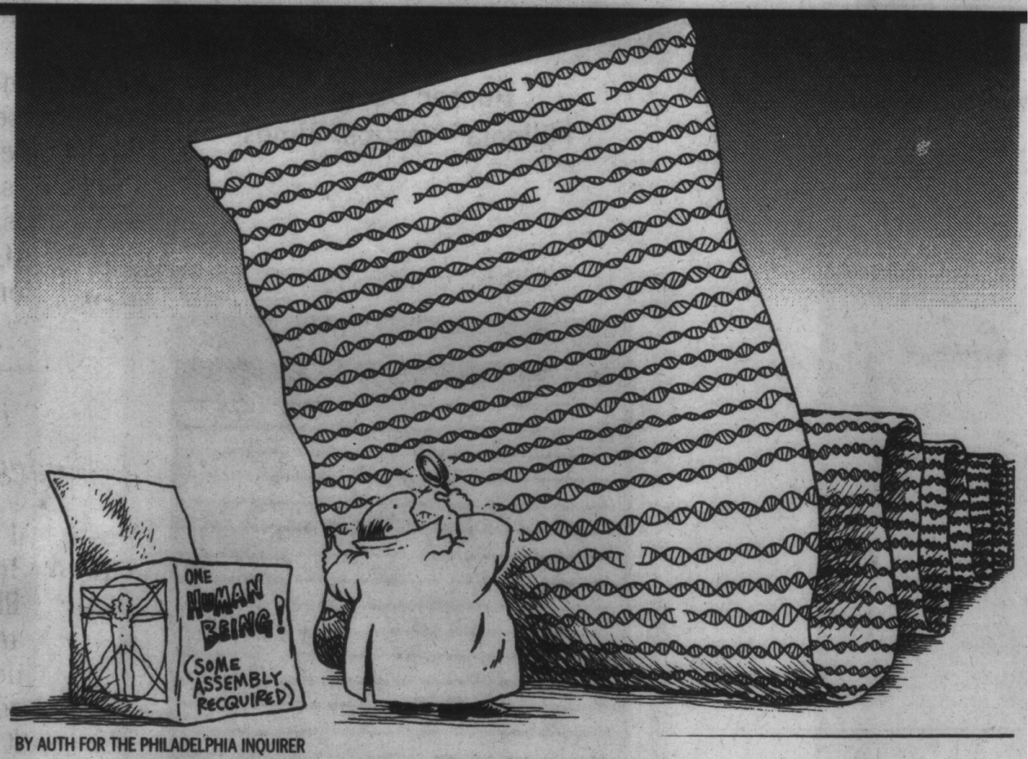
Genome Assembly
3
Notes:
3

Slide 4
Genome Sequencing
Genome is all of the genetic material of an organism
Contained in DNA or RNA (in some viruses)
Genome are very long
Human genome is 3 billion base pairs
Small bacterial genomes are few million base pairs
But sequencing machines cannot read whole genome at a time
Can determine small fragments called reads
Genome assembly
Computational problem of merging reads to construct the whole genome

Slide 5
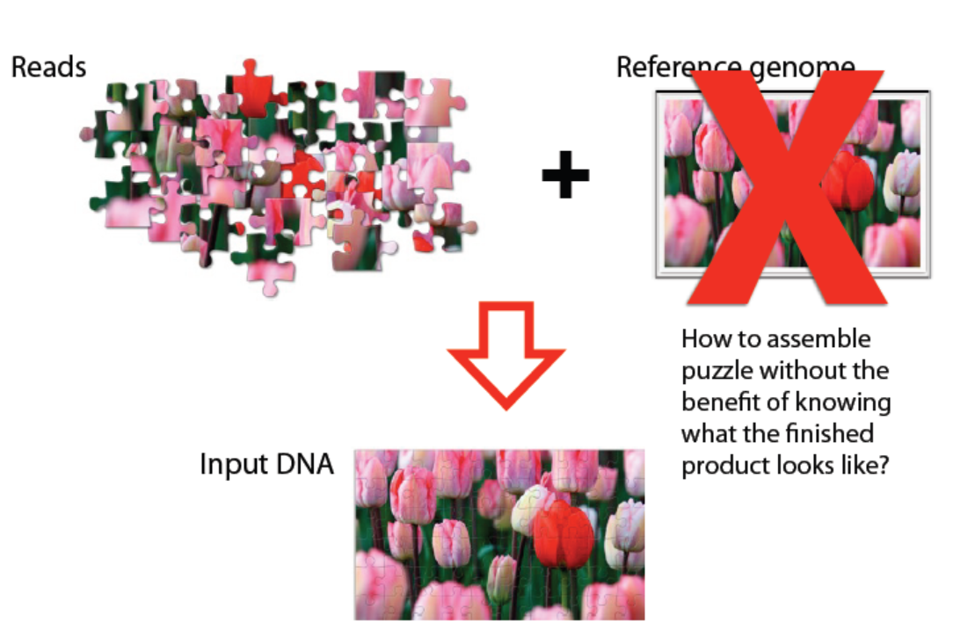
Genome Assembly

Slide 6

Genome Sequencing
Start with many copies of genome
Fragment them and read one or both ends
Find overlapping reads (overlap or de Bruijn graph)
…ACGTTTGCTATCCGATTA
TGCTATCCGATTAGGTATTCA…
Merge them into contigs
…ACGTTTGCTATCCGATTAGGTATTCA…
Scaffold contigs using paired end reads

Slide 7
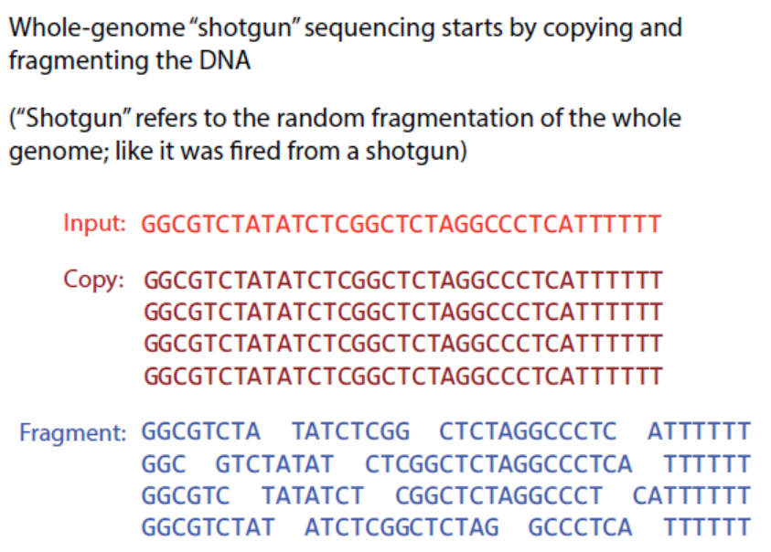
Assembly

Slide 8
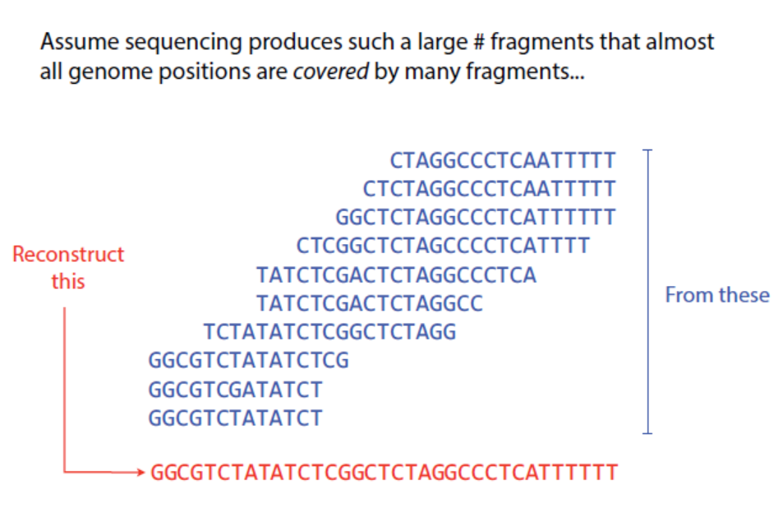
Assembly

Slide 9
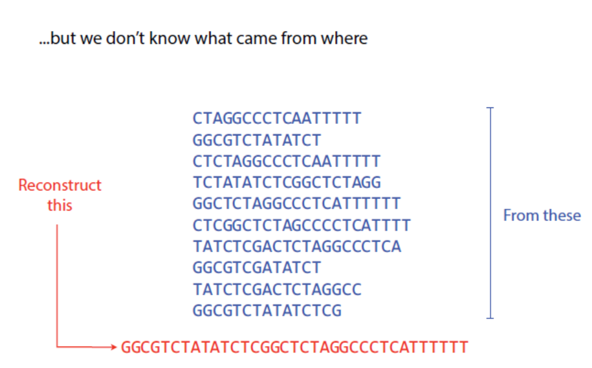
Assembly

Slide 10
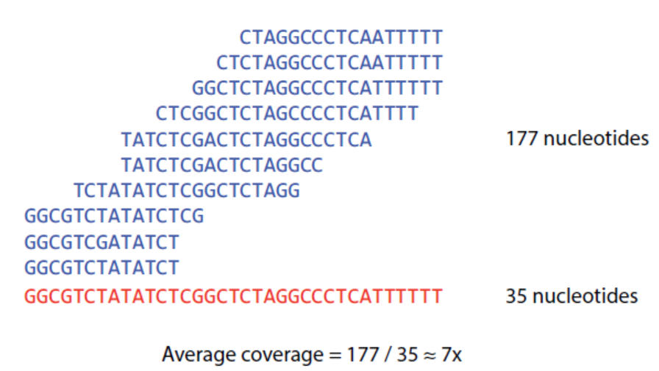
Assembly: coverage
The average number of reads covering a position in the genome

Slide 11
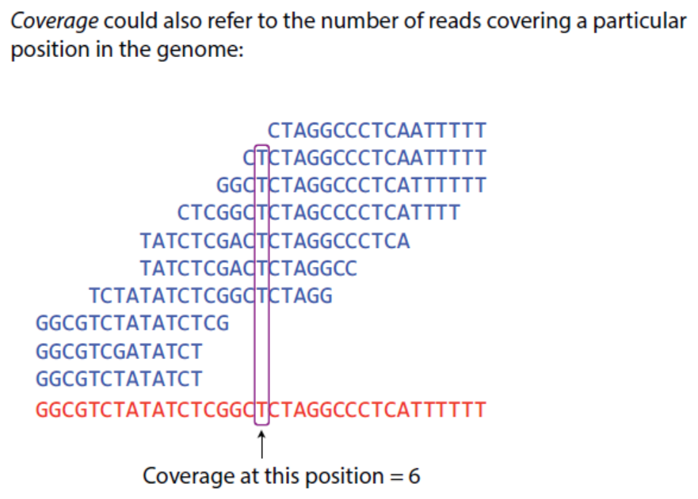
Assembly: coverage

Slide 12
Typical contig coverage
Imagine raindrops on a sidewalk

Slide 13
Assembly: coverage
Shallow Sequencing: low coverage
Deep Sequencing: high coverage
Sequencing technologies should be considered!

Slide 14
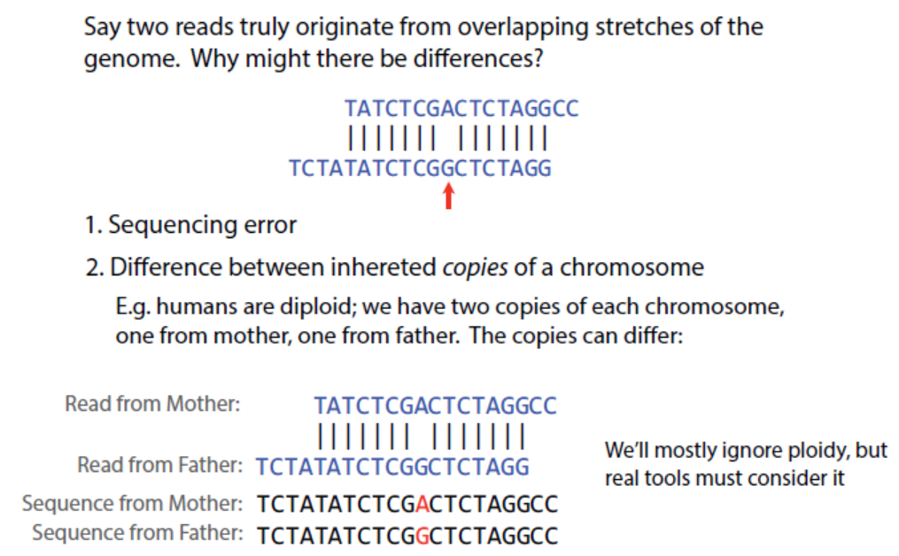
Assembly

Slide 15
Basic Challenge
Given many (millions or billions) of reads, produce a linear (or perhaps circular) genome
Two main challenges:
Depends on read length, number of reads, size of genome, etc.
Depends on coverage, repeat size and repeat frequency
Getting sufficient “coverage” of the genome
Assembling the reads into a complete genome

Slide 16
Basic Challenge contd.
Given many (millions or billions) of reads, produce a linear (or perhaps circular) genome
Issues:
Coverage
Errors in reads
Reads vary from very short (35bp) to quite long (800bp), and genomes are double stranded
Repeats
Double strandedness
Running time and memory

Slide 17
Sequencing error
Mistakes made by sequencing machines
GATTACGGGTTCGGGTA
GATAA
TTACG
TGACG
GGGTT
TT_GGT
GGGTA
Substitution
Insertion
Deletion

Slide 18
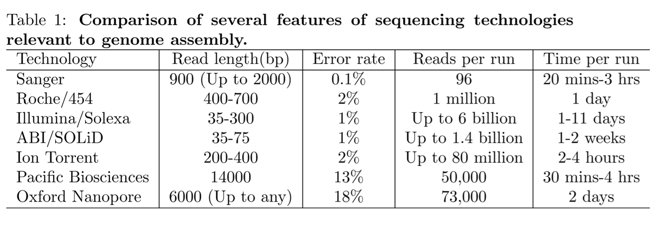
Sequencing error

Slide 19
Challenge: Repeats
A
R
B
R
C
Problematic when:
Repeats are longer than read lengths
Repeats are present in many copies

Slide 20
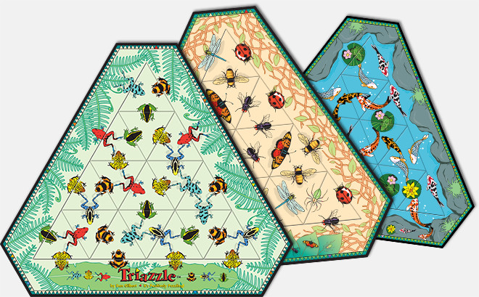
Challenge: Repeats
Looks deceivingly simple!
For every triangle, there is a variety of matching triangles.
Harder than the jigsaw puzzles with thousands of pieces
Dan Gilbert Art Group http://www.dangilbert.com/triazzle.php

Slide 21
Challenge: Repeats
A
R
B
R
C
Collapsing repeats
A
R
B
C

Slide 22
Read length matters
Reads (much) longer than repeats – assembly should be easy
Reads (roughly) equal to the repeats – assembly computationally difficult (NP-hard)
Reads shorter than repeats – assembly undetermined.
Multiple genomes can fit into the data!
Nagrajan, Pop. J. Comp. Biol. 2009, Kingsford et al., BMC Bioinformatics, 2010

Slide 23
Simplest Scenario
Reads have no error
Reads are long enough that each appears exactly once in the genome

Slide 24
De novo and comparative assembly
De novo assembly means you do everything from scratch
Comparative assembly means you have a “reference” genome. For example, you want to sequence your own genome, and you have Craig Venter’s genome already sequenced. Or you want to sequence a chimp genome and you have a human already sequenced.

Slide 25
Comparative Assembly
Much easier than de novo!
Basic idea:
Take the reads and map them onto the reference genome (allowing for some small mismatch)
Collect all overlapping reads, produce a multiple sequence alignment, and produce consensus sequence

Slide 26
Comparative Assembly
Fast
Short reads can map to several places (especially if they have errors)
Needs close reference genome
Repeats are problematic
Can be highly accurate even when reads have errors

Slide 27
De novo assembly
Much easier to do with long reads
Need very good coverage
Generally produces fragmented assemblies
Necessary when you don’t have a closely related (and correctly assembled) reference genome

Slide 28
De Novo Assembly paradigms
Overlap Graph:
overlap-layout-consensus methods
greedy (TIGR Assembler, phrap, CAP3...)
graph-based (Celera Assembler, Arachne)
k-mer graph
Construc k-mer graphs from the reads
Original reads are discarded
Especially useful for assembly from short reads
28
Notes:
28

